Slide 1


Cyberbullying and Fake Account Detection in Social Media
Vivekanand Education Society’s Institute Of Technology
Department Of Computer Engineering
Project Review 1
Mentor Details:
Name: Prof. Richard Joseph
Designation: Asst. Prof. VESIT
Group Members:
Jayesh Samtani D17A-57
Sagar Sidhwa D17A-62
Somesh Tiwari D17A-71
Riya Wadhwani D17A-74
Notes:
NOTE:
To change the image on this slide, select the picture and delete it. Then click the Pictures icon in the placeholder to insert your own image.

Slide 2
INDEX
Vivekanand Education Society’s Institute Of Technology
Department Of Computer Engineering

Slide 3
Index
Introduction
Lacuna in the existing systems
Problem Definition
Goals
Literature Survey
Methodology employed
Hardware & Software
Tools
Constraints
Block Diagram
Data Flow Diagrams
Conclusion
References

Slide 4
INTRODUCTION
Vivekanand Education Society’s Institute Of Technology
Department Of Computer Engineering

Slide 5
Introduction
Cyber Crime and Bullying have increased on Social Networking sites with having more than 50 Crores active users until now, so the misuse of the Online Social Platform had taken place in several times for e.g Bullying Someone by sending the harmful messages ,spreading of the harassment messages by using the fake accounts, using the abusive words on the social media etc
In a recent report it was found that nearly 25% of People, especially teens and young adults are finding new ways to bully one another over the Internet and parents don’t know that their child has been involved in a cyberbullying incident.
A Preventive measure to STOP the above crimes caused a need for different Machine Learning algorithms for detection of the Cyber Crime and Bullying and the fake accounts so as to report these issues to the system immediately and to stop the crimes to increase in future and develop a secure online environment.

Slide 6
LACUNA IN THE EXISTING SYSTEM
Vivekanand Education Society’s Institute Of Technology
Department Of Computer Engineering

Slide 7
Lacuna In The Existing System
Lack of Security
No Transparency
Only one algorithm is Implemented
Costly to produce reports

Slide 8
PROBLEM DEFINITION
Vivekanand Education Society’s Institute Of Technology
Department Of Computer Engineering

Slide 9
Problem Definition
Nowadays, cybercrime is one of the common issues everyone is facing and it is impacting the people, in which some are long period of sadness, anger, irritability, loss of interest in activities, being restless, anxious and worried, even in some cases they go into depression and take steps to scarify their life.It is unfortunate that there are no special Anti-Cyberbullying Laws in India yet.There are some common types of cyberbullying that is Flaming, Harassment, Denigration,Impersonation,Trickery. So to detect cyberbullying we have to make some software that will detect it and then report it to www.cybercrime.gov.in. Similarly, we will detect fake accounts.

Slide 10
GOALS
Vivekanand Education Society’s Institute Of Technology
Department Of Computer Engineering

Slide 11
Goals Of The System
Automatic detection of cyberbullying in social media
Identifying Fake Accounts
To Reduce Malicious Activities
To Prevent People Especially Teens From Bully Activities
To Avail more Security and Openness

Slide 12
LITERATURE SURVEY
Vivekanand Education Society’s Institute Of Technology
Department Of Computer Engineering

Slide 13
Literature Survey
Title : Fake Twitter accounts: Profile characteristics obtained using an activity-based pattern detection approach
Link : https://people.clarkson.edu/~jmatthew/publications/SMS_gurajala_original.pdf
Inference : From this paper we got the information about the fake account dataset quantity, because due to the low number of false positives of fake account data accuracy of model decreased even if the twitter profile database was approx 60 million.
Title : Detection of Behavior Patterns through Social Networks likeTwitter, using Data Mining techniques as a method to detect Cyberbullying
Link: https://www.researchgate.net/publication/322514911_Towards_the_detection_of_cyberbullying_based_on_social_network_mining_techniques
Inference : In the analysis stage we use data mining techniques to generate a dictionary of pejorative terms that are related to cyberbullying and thus be able to generate behavior patterns of these terms. And in this way provide better tools so that psychology specialists can optimize their work. The results show which platform is more flexible, and also shows which is best suited to the search of incidences of cyberbullying on Twitter.
Title : Classification of Cyberbullying in Facebook Using Selenium and SVM
Link : https://www.researchgate.net/publication/327635426_Classification_of_Cyberbullying_in_Facebook_Using_Selenium_and_SVM
Inference : In this paper facebook data were used for classification using Support Vector Machines (SVM) models. A total of 2263 data was used for training data, Facebook posts. Based on these posts, the study achieved the precision of 88% and the recall is 87%. So it is quite good algorithm for cyberbully detection

Slide 14
METHODOLOGY APPLIED
Vivekanand Education Society’s Institute Of Technology
Department Of Computer Engineering

Slide 15
Methodology Applied
The proposed approach contains three main steps namely Preprocessing, features extraction and classification step.
In the preprocessing step from the cyberbullying dataset we had used the parameters - Offensive or Not,Text(e.g Messages or Posts) and from the fake account dataset the parameters used are - Name, Status Count, Followers Count, Friends Count ,Url, Time Zone, Listed Count ,Screen Name ,Profile Bio,Location .
we clean the data by removing the noise and unnecessary text.
The preprocessing step is done in the following: -
Tokenization
Lowering text
Stop words and encoding cleaning
The second step of the proposed Model is the features extraction step. In this step the textual data is transformed into a suitable format applicable to feed into machine learning algorithms

Slide 16
Methodology Applied
The last step in the proposed approach is the classification step where the extracted features are fed into a classification algorithm to train, and test the classifier and hence use it in the prediction phase. We will use classifiers, namely, SVM (Support Vector Machine), Naive Bayes,Random Forest,Decision Tree , Logistic Regression and Neural Network.
Accuracy of different algorithms will be Compared to get the best possible result.
For the fake profile detection the detection process starts with the selection of the profile that needs to be tested. After selection of the profile the suitable attributes ie., features are selected on which the classification algorithm is being implemented ,the attributes extracted are passed to the trained classifier.
Different Classifier algorithms such as Gradient Booster, Random forest Decision trees ,Support Vector Machine and Neural Networks such as RNN and CNN can be used.
Effectiveness of the proposed method is accomplished by machine learning methods. Here cross-validation technique, and the basic metrics and evaluation of the classifier performance will be used.

Slide 17
SPECIFICATIONS
Vivekanand Education Society’s Institute Of Technology
Department Of Computer Engineering

Slide 18
Hardware & Software Specifications
Intel Pentium Processor
RAM>=4GB
Anaconda
Visual Studio

Slide 19
Tools
Django
Machine Learning Algorithms
Python Libraries
Windows 10 SDK

Slide 20
Constraints
Continuous network connectivity required
Process or requirement varies according to the Dataset

Slide 21
BLOCK DIAGRAM
Vivekanand Education Society’s Institute Of Technology
Department Of Computer Engineering

Slide 22
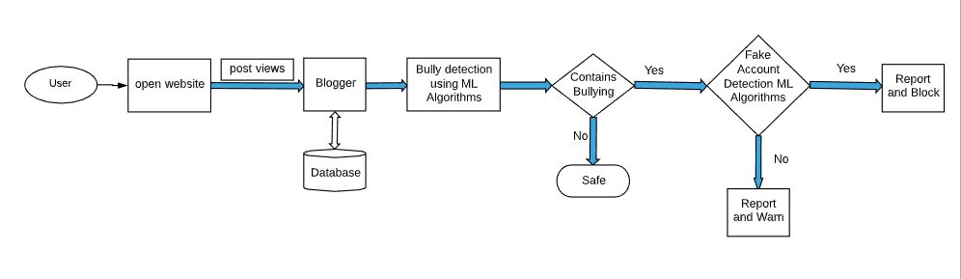
Block Diagram

Slide 23
DATA FLOW DIAGRAMS
Vivekanand Education Society’s Institute Of Technology
Department Of Computer Engineering

Slide 24
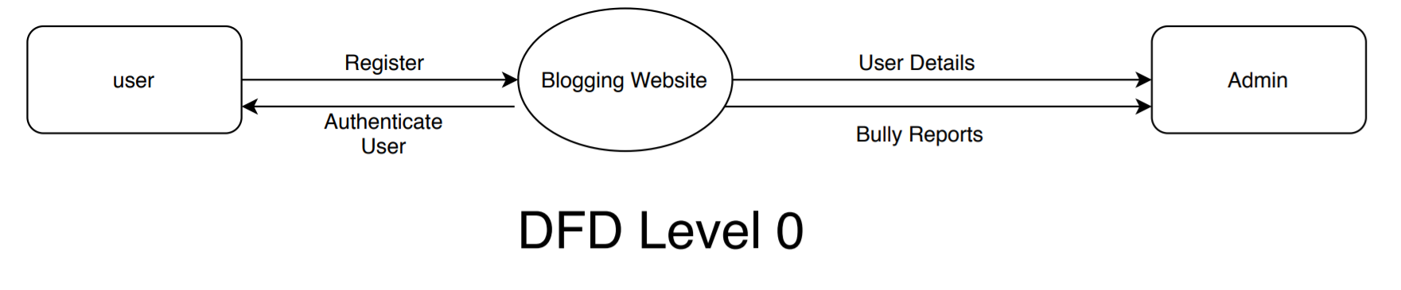
DFD Level 0

Slide 25
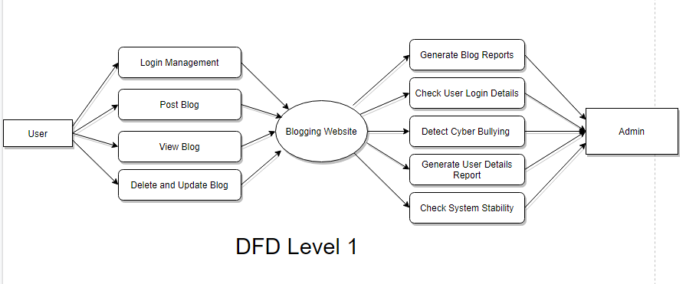
DFD Level 1

Slide 26
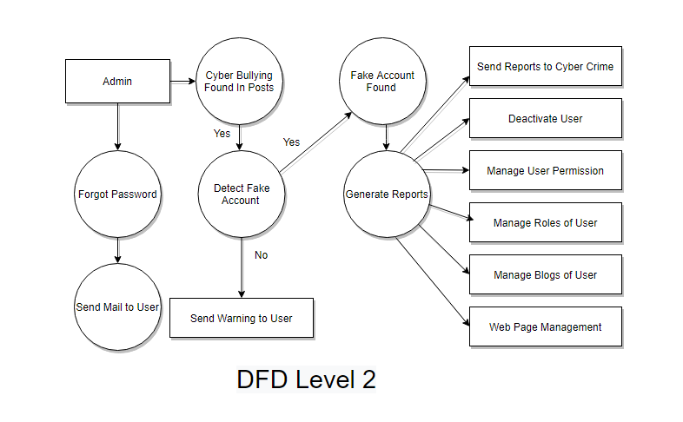
DFD Level 2

Slide 27
CONCLUSIONS
Vivekanand Education Society’s Institute Of Technology
Department Of Computer Engineering

Slide 28
Conclusion
In this project, we proposed an approach to detect Cyberbullying and Fake Account Detection using machine learning techniques.
We will evaluate our model on Different ML Algorithms and we will also use Countvectorizer for features extraction By using machine learning algorithms to its full extent.
We will eliminate the need for manual prediction of a fake account, which needs a lot of human resources and is also a time-consuming process.

Slide 29
REFERENCES
Vivekanand Education Society’s Institute Of Technology
Department Of Computer Engineering

Slide 30
References
S. Gurajala, J. S. White, B. Hudson, and J. N. Matthews, “Fake Twitter accounts: Profile characteristics obtained using an activity-based pattern detection approach,” in Proceedings of the 2015 International Conference on Social Media & Society , Toronto, Ontario, Canada, 2015.View at: Publisher Site | Google Scholar.
N. V. Chawla, K. W. Bowyer, L. O. Hall, and W. P. Kegelmeyer, “SMOTE: synthetic minority over-sampling technique,” Journal of Artificial Intelligence Research, vol. 16, pp. 321–357, 2002.View at: Google Scholar
I. Jolliffe, Principal Component Analysis, 2002.View at: MathSciNet.
S. Sperandei, “Understanding logistic regression analysis,” Biochemia Medica, vol. 24, no. 1, pp. 12–18, 2014.View at: Publisher Site | Google Scholar..

Slide 31
THANK YOU
Vivekanand Education Society’s Institute Of Technology
Department Of Computer Engineering

